Slide 1


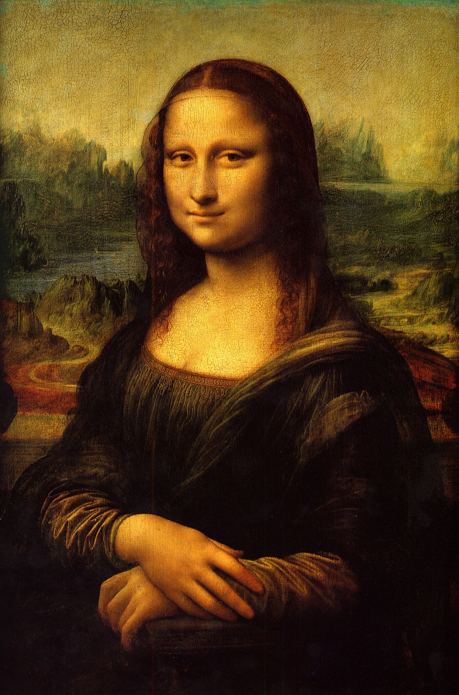









Target image
Canvas
Textures

Slide 2

Target image
Canvas

Slide 3
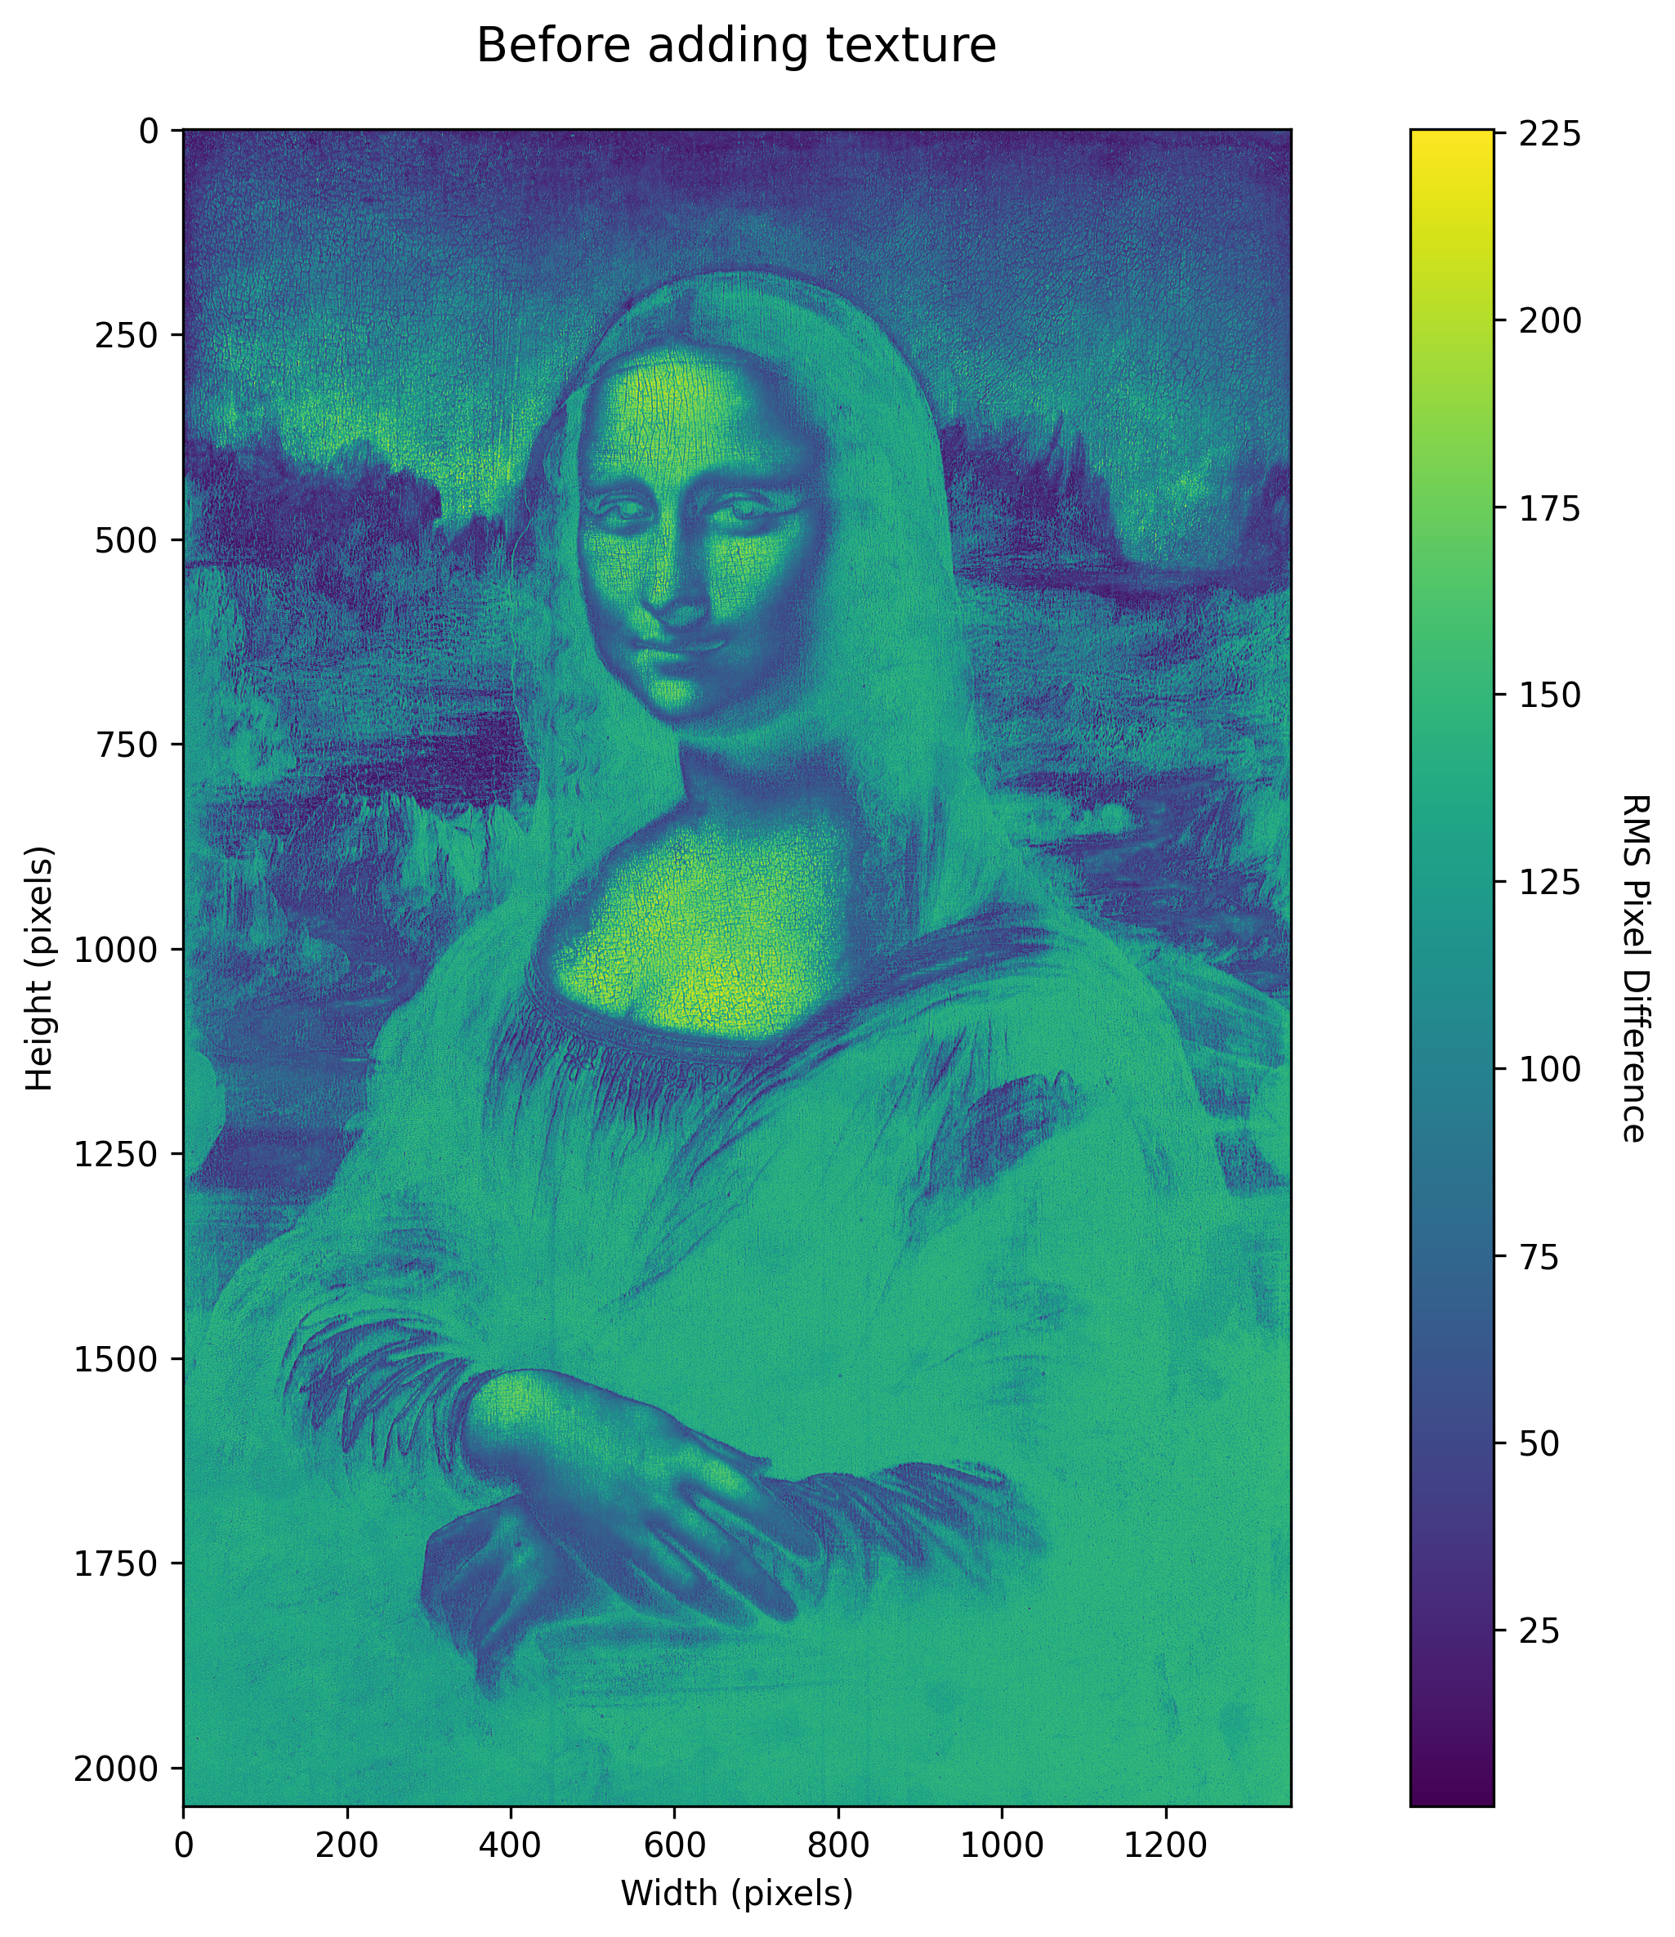
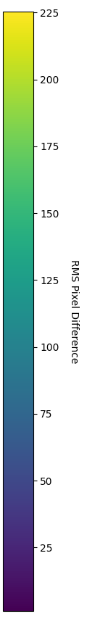
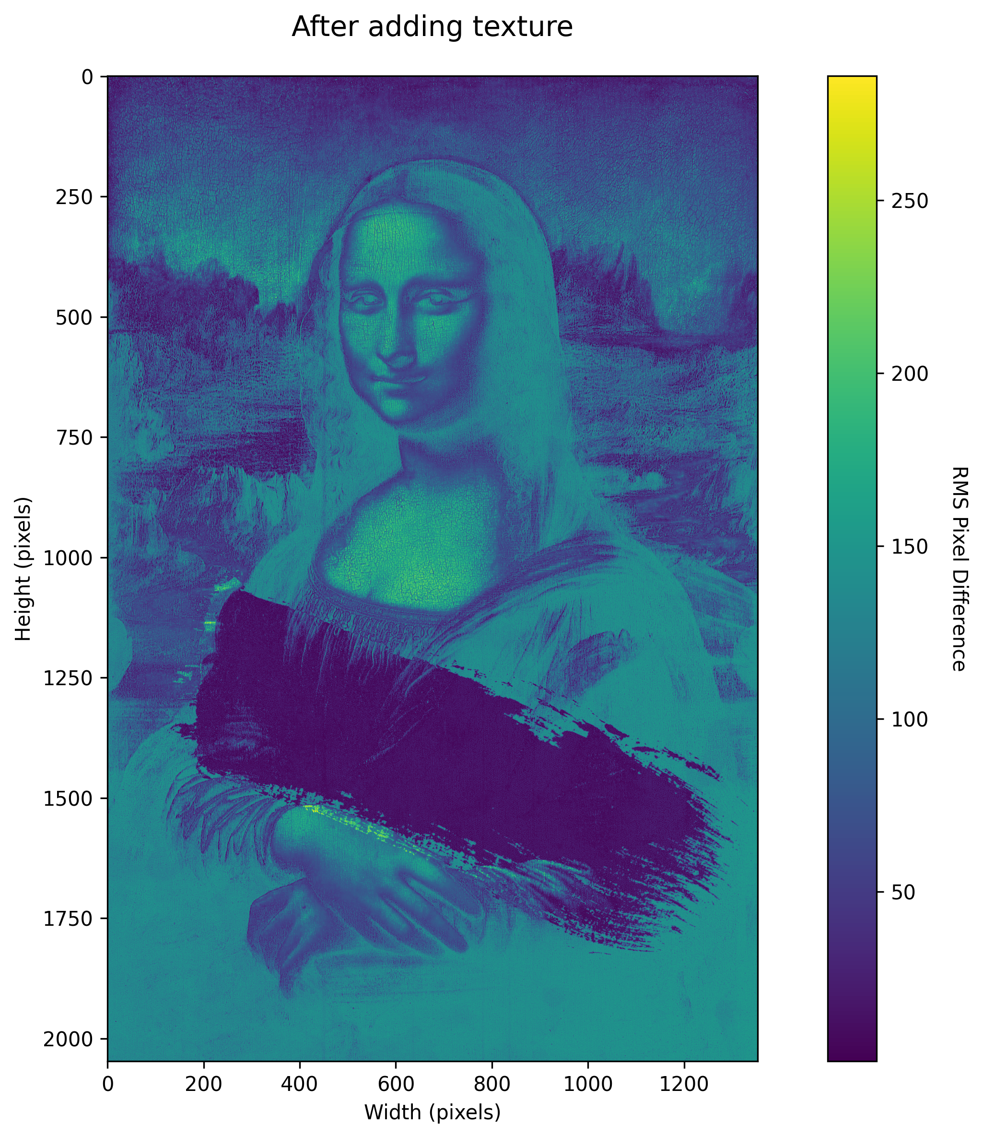
High RMSE
RMSE
(Before)
,
RMSE
(After)
,
Low RMSE

Slide 4
Before RMSE
After RMSE

